Slide 1

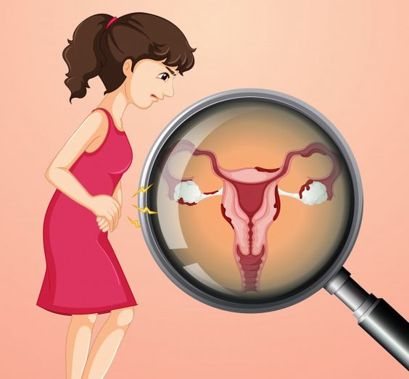
POLY- CYSTIC OVARY SYNDROME (PCOS)
DETECTION OF
BY:
pRATIKSHA PRADHAN
& FATHIMA SALIM
(Group 2)
Date: 14th April, 2023

Slide 2
TABLE OF CONTENTS
Problem Setting
Problem Definition
Data Source and Description
Data Exploration
Data Mining Tasks
Data Mining Models
Performance Evaluation
Project Results
Project Impact

Slide 3

PROBLEM SETTING

Slide 4
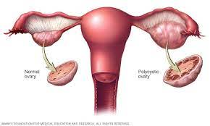
PROBLEM DEFINITION
In extreme cases, PCOS puts women at risk for type II diabetes, endometrial cancer, cardiovascular diseases, and can lead to reproductive morbidity. Early diagnosis and subsequent follow-ups help reduce such risks.
The idea behind our project is to determine the best classification model and predictors for accurately detecting PCOS early on, so that women are able to take appropriate corrective measures.
Source: Mayo Clinic

Slide 5
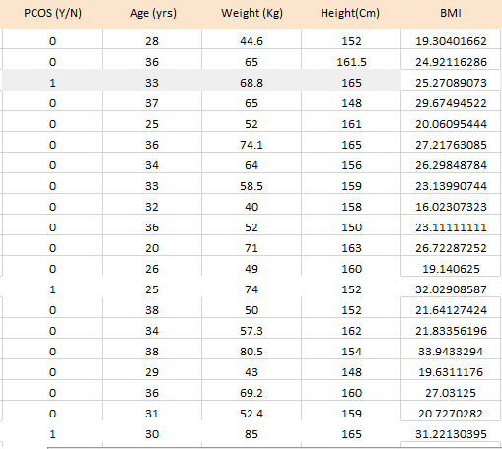
DATA SOURCE AND DESCRIPTION
The data is taken from Kaggle.
The dataset consists of 541 rows, indicating the details of 541 patients from 10 hospitals across Kerala, India.
The number of columns is 45, including the response variable PCOS (Y/N).
We have discrete numeric variables (age), continuous numeric variables (weight), nominal categorical variables (blood group), and binary numeric (weight gain).
For any Yes/No attributes, Yes=1 and No=0.
Blood groups are indicated as follows: A+=11, A-=12, B+=13, B-=14, O+=15, O-=16, AB+=17, AB-=18.

Slide 6
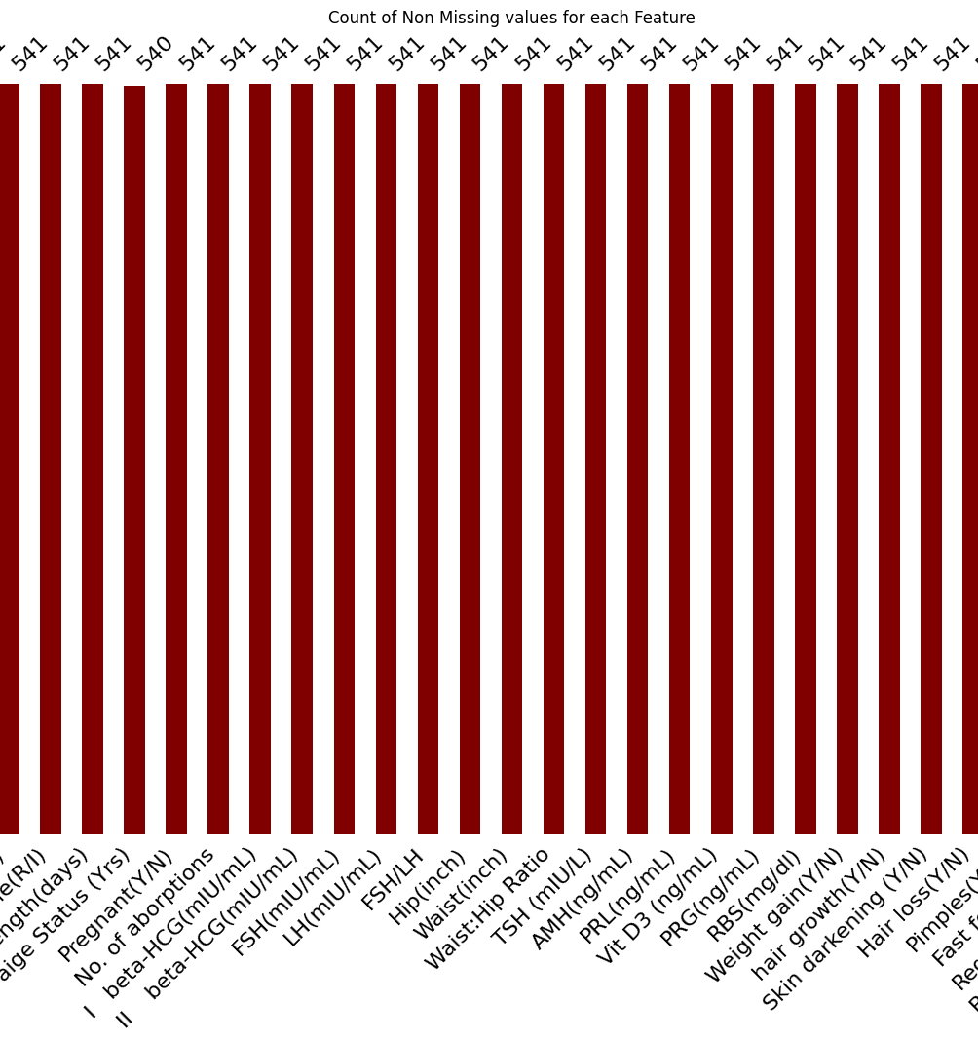
DATA EXPLORATION
Converting Data Types- AMH(ng/mL) and II beta-HCG(mIU/mL) were converted to numeric from object.
Exploring Missing Values- We had only one column with around 44 missing values and it was hence dropped.
Imputing Null Values- The null values were imputed with the median since mean is sensitive to outliers and there were significant outliers in the data.

Slide 7
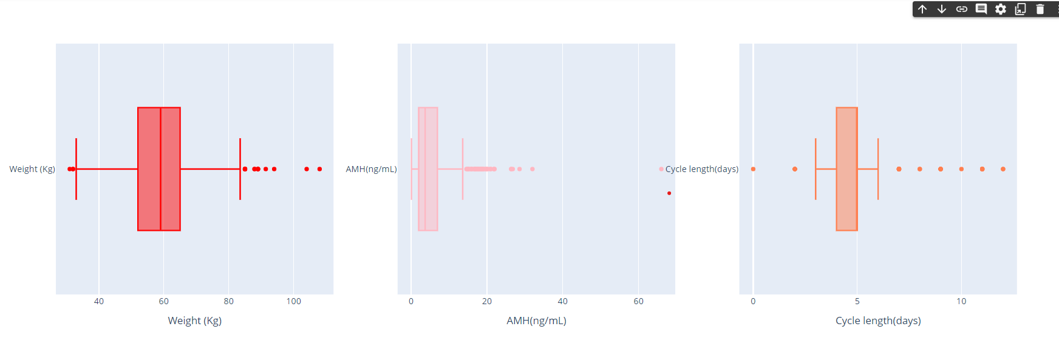
DATA EXPLORATION
Outlier Analysis: After some inspection of the mean, min and max values of different columns, we visualized some of the features using boxplots. These are columns with some major outliers.

Slide 8
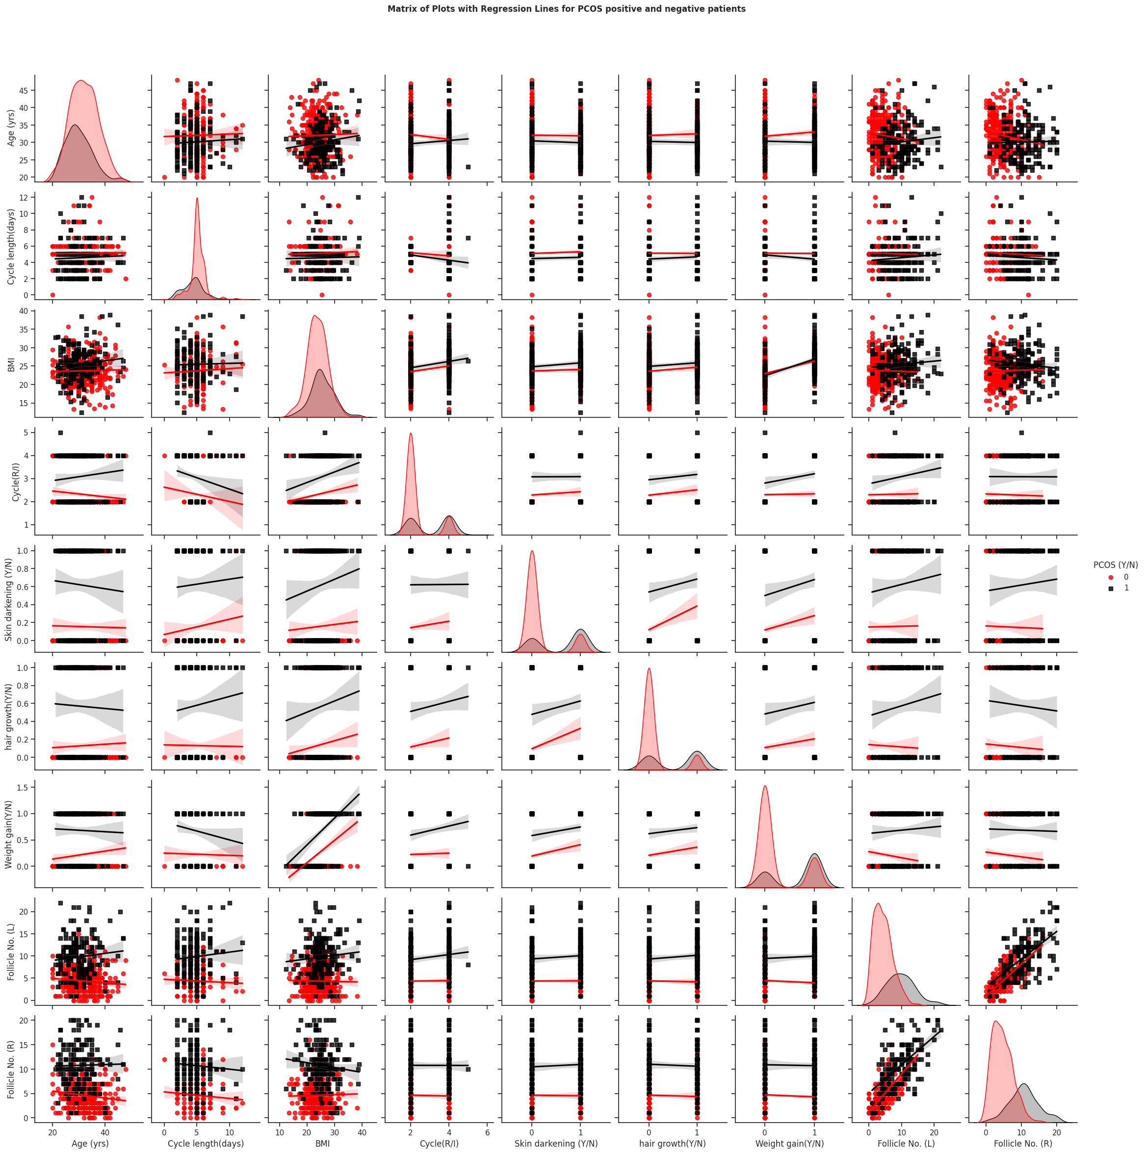
DATA EXPLORATION

Slide 9
DATA EXPLORATION
We can see that BMI is consistent for people without PCOS as age increases but for people with PCOS BMI increases with age. For the number of days of the menstrual cycle it's consistent for people without PCOS while for people with PCOS the number of days is comparatively less but it increases with age.
For people with PCOS, skin darkening is more prominent at a younger age and reduces with age. For people without PCOS, skin darkening is not very prominent and there is not much difference as they age. As for hair growth, there is more hair growth among people with PCOS, especially at a younger age, and this decreases as the women age. For people without PCOS, hair growth slightly increases with age but is much lesser than in people with PCOS.
Follicles are underdeveloped sacs in which eggs develop. Since the left and right follicles have the highest correlation value wrt to target variable after plotting the same, we can see that follicle values are comparatively higher for people with PCOS for both left and right.

Slide 10
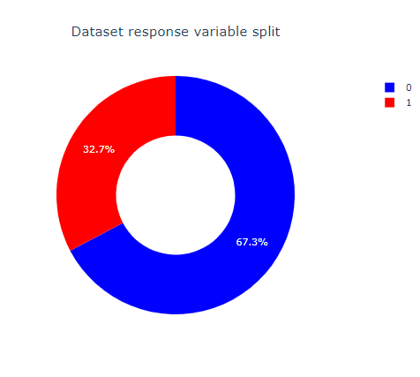
DATA MINING TASKS
Oversampling
We can see that there is an imbalance in the dataset and our class of interest comprises only 32% of the dataset.
Oversampling is a technique used in machine learning to address the problem of imbalanced datasets.
We used Synthetic Minority Oversampling Technique (SMOTE) to address the imbalance in our dataset. In SMOTE, we duplicate examples that are close in the feature space, drawing a line between the examples in the feature space and a new sample at a point along that line. In this way, we duplicate examples from the minority class prior to fitting a model.

Slide 11
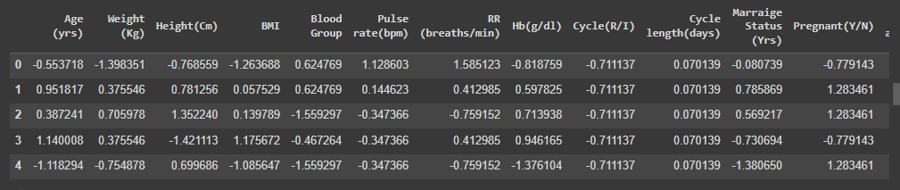
DATA MINING TASKS
Splitting, Standardization and Scaling
The hold-out method is used for data partitioning, such that the train and test sets were generated in the ratio of 70:30.
If the features have different scales, the model may place undue importance on the feature with the larger scale, leading to inaccurate predictions.
Standardization and scaling help to normalize the features, allowing the model to learn from all the features equally and make more accurate predictions.

Slide 12
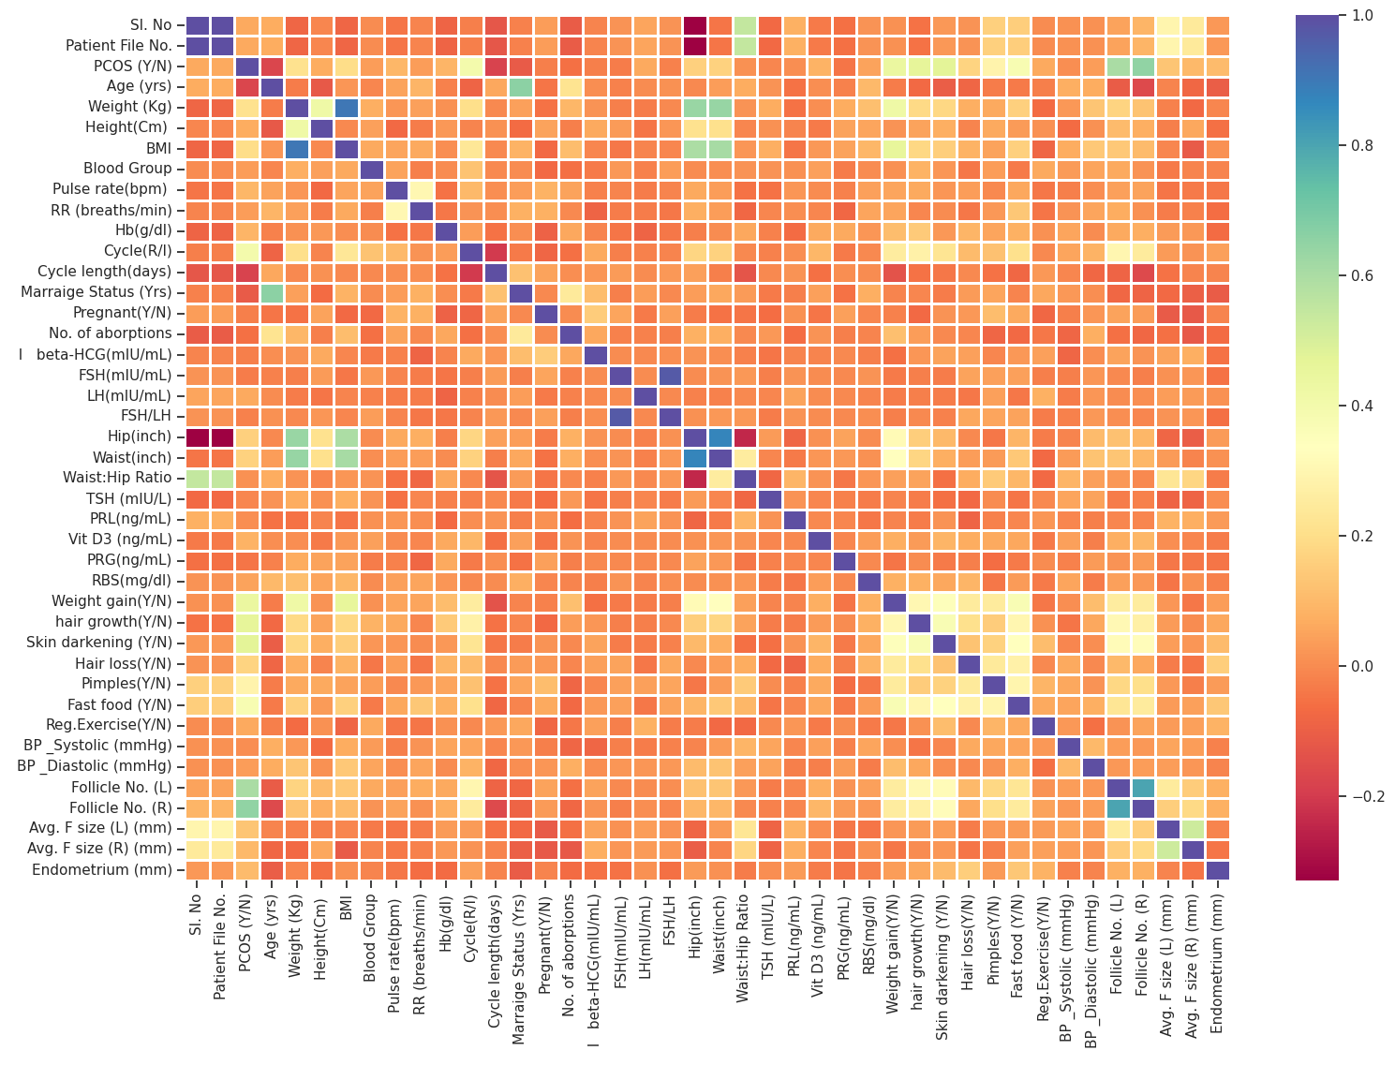
DATA MINING TASKS
Dimension Reduction
We drop redundant columns such as Sl.No in the data cleaning process.
We calculate the correlation matrix and plot it as a heatmap.
We dropped FSH/LH since it has a correlation value of 0.95 with FSH.
We also drop Waist(inch) and Hip(inch) as we already have a column with their ratio.
We further reduce the dimensions as we implement each model by considering their feature importance scores.

Slide 13
DATA MINING MODELS
Since our problem is a classification problem, the following models were used:
Logistic Regression
Naïve Bayes
Decision Trees
Random Forest
Gradient boost

Slide 14
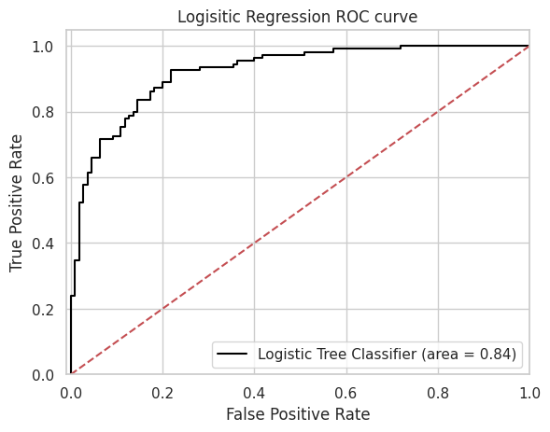
LOGISTIC REGRESSION
About the model: Parametric model that generates the output as probability estimates for each class and uses a threshold for classification
Why we use this model: Logistic Regression is used for classification tasks and works well with small datasets.
Disadvantage: It is sensitive to outliers in the data.
Hyperparameters used: C=0.00026366508987303583, penalty=L2
Feature importance: We use odds to calculate feature importance
Accuracies: Training accuracy comes to 88% while testing accuracy is 84%

Slide 15
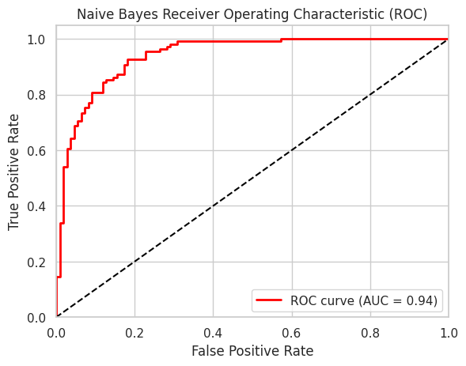
NAÏVE BAYES
Gaussian Naive Bayes is a probabilistic machine learning algorithm that is commonly used for classification tasks. It is based on the Bayes theorem and assumes that the features are independent and have a Gaussian distribution.
Advantages: Can perform reasonably well even with small amounts of training data and can handle datasets with large number of features or attributes.
Disadvantages: Assumes that all features are independent of each other, and that the features are normally distributed or follow a specific distribution.
Accuracy on test set before hyperparameter tuning: 83.11%
Accuracy on test set after hyperparameter tuning using grid search and best feature selection: 85.84%
AUC value also increased from 0.90 -> 0.94

Slide 16
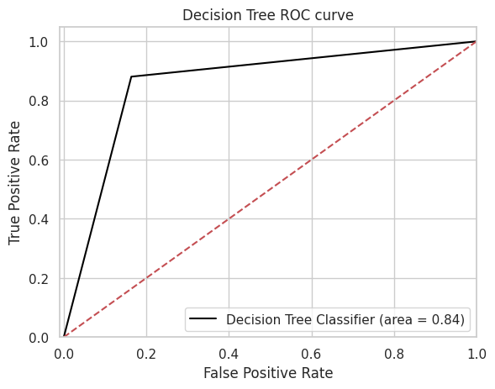
DECISION TREES
About the model: Non-parametric model that generates splits to increase homogeneity after each split.
Why we use this model: Decision trees are robust to outliers and feature selection is intrinsic, hence the number of predictors used will also reduce.
Disadvantage: Large trees are prone to overfitting.
Hyperparameters used: Criterion= ‘entropy', max_depth= 8, max_features= 20, min_samples_split=4
Feature importance: We use the feature importance attribute to calculate the feature importance scores and select the top few features.
Accuracies: Training accuracy comes to 99% while testing accuracy is 85%

Slide 17
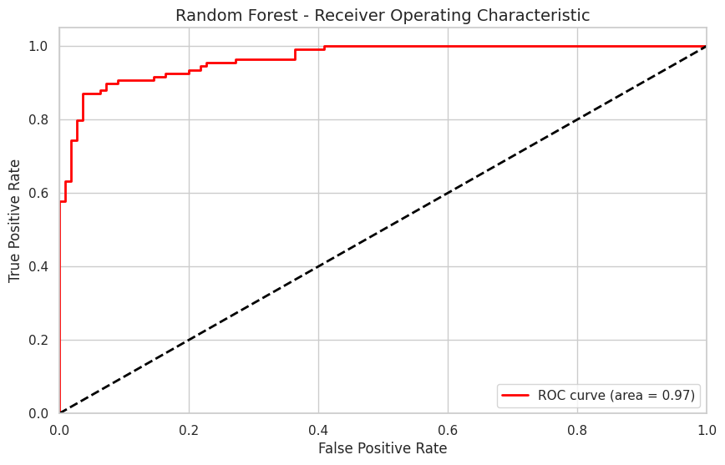
RANDOM FOREST
Random Forest is a popular machine learning algorithm used for both classification and regression tasks. It is an ensemble method that combines multiple decision trees to create a more accurate and robust prediction model.
Advantages: Provides robust and accurate predictions, can handle dataset with large number of features, robust to noise and outliers
Disadvantages: Prediction speed can be slow and its computationaly expensive.
Hyperparameters used: max_depth=20, max_features=3, min_samples_leaf=2 min_samples_split=8, n_estimators=50
Accuracy of the model on train set: 99.41%
Accuracy of the model on test set: 90.41%

Slide 18
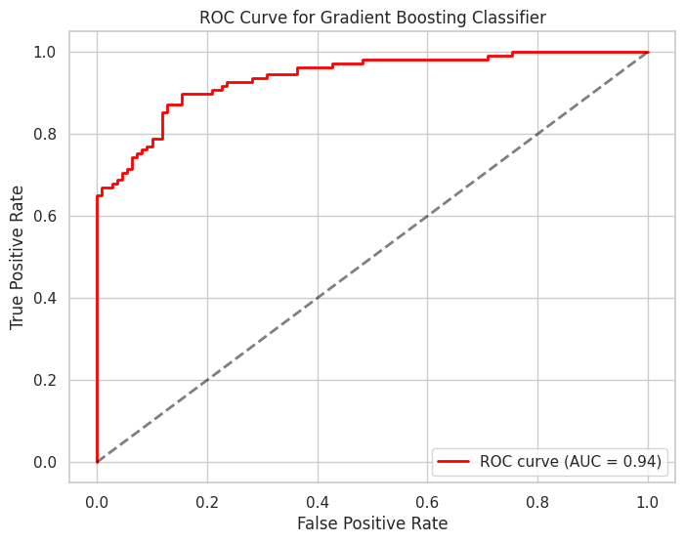
GRADIENT BOOST
Gradient boosting is an ensemble technique where multiple weak learners (often decision trees) are sequentially combined to create a more accurate and robust predictive model.
Advantages: High accuracy, handles different kinds of data, wide range of hyperparameters for customization, provides feature importance scores.
Disadvantages: Highly complex, potential overfitting, require significant computational resources.
Hyperparameters used: learning_rate= 0.2, max_depth= 3, min_samples_leaf=0.4, min_samples_split=1.0, n_estimators =150
Accuracy of the model on train set: 88.41%
Accuracy of the model on test set: 85.84%

Slide 19
PERFORMANCE EVALUATION
Model | Training Accuracy | Testing Accuracy | Sensitivity | Precision | F1 Score | AUC
Logistic Regression | 88.8% | 84.01% | 85% | 83% | 84% | 0.84
Naïve Bayes | 86.05% | 85.84% | 87% | 85% | 86% | 0.94
Decision Tree | 99% | 85.84% | 88% | 84% | 86% | 0.84
Random Forest | 99.41% | 90.41% | 91% | 90% | 90% | 0.97
Gradient Boost | 88.41% | 85.84% | 90% | 83% | 86% | 0.94

Slide 20
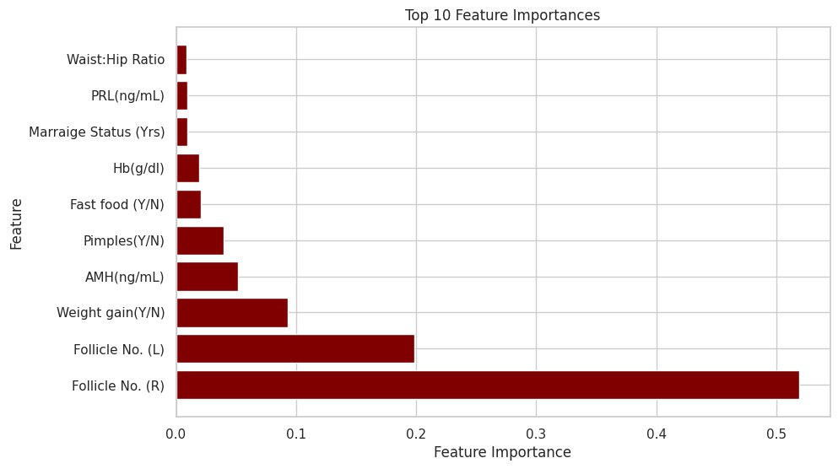
PROJECT RESULTS
Chosen model: We finally choose the Gradient Boost model as it is an ensemble technique and a very flexible model, which is a good option for a dataset like ours with a mix of categorical and numeric variables. We get high accuracy (85.84%), close to no overfitting (training accuracy and testing accuracy are pretty close), high sensitivity (90%, which is desired as we want to give more importance to our class of interest).
Challenges:
Not enough data is readily available.
Our dataset has 541 records and 45 features, which makes it prone to overfitting.
We had to reduce the dimensions but since our dataset has a mix of numeric and categorical variables, we were unable to implement any one dimensionality reduction technique.
We had to implement other methods including grid search for hyper parameter tuning, which in some cases is not very computationally efficient.

Slide 21

PROJECT IMPACT
The diagnostic criteria in use for PCOS is very ambiguous and involves a lot of factors. Our proposed model can be implemented in the healthcare industry for early screening based on patient information. The doctors can intimate such patients and assist them in making changes to their lifestyle and scheduling regular check-ups.
Future work:
Since PCOS diagnosis depends on multiple factors, we could also use imaging techniques to analyze ultrasounds and the like and integrate these into our model to get more accurate results.
2. As PCOS is a chronic condition and evolves over time, models can be built to learn this evolution. Such models can also be used to understand how different medical treatments can affect PCOS related attributes.

Slide 22
REFERENCES
https://www.healthline.com/health/polycystic-ovary-disease
https://www.kaggle.com/datasets/prasoonkottarathil/polycystic-ovary-syndrome-pcos
https://www.youtube.com/watch?v=Mc5iK0AtGNc&t=251s

Slide 23
THANK YOU!

